Slide 1
Lifestyle and Well-Being of Employees
01
02
03
Archana Kanuri,
Imtiaz Chowdhury,
Meghana Korada,
Siddarth Gopalakrishnan
Team 12

Slide 2
Components of Well-being
Well-Being
1
2
3
Mental Well-being
Physical Well-being
Overall Satisfaction
Daily Stress Level
BMI Range
Work-life Balance Score

Slide 3
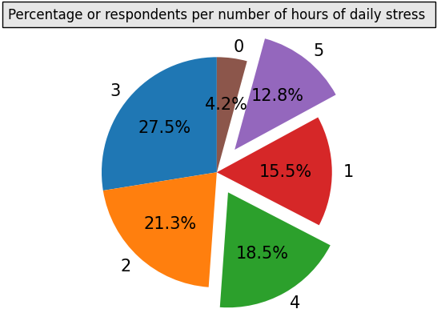
Distribution of Daily Stress Levels Among Respondents
Most respondents experience 3-4 hours of daily stress, indicating moderate but persistent pressure.
A small but notable group (12.8%) experiences high stress (5+ hours), requiring intervention or stress management strategies.
Very few people report stress-free days, showing that daily stress is a widespread issue.

Slide 4
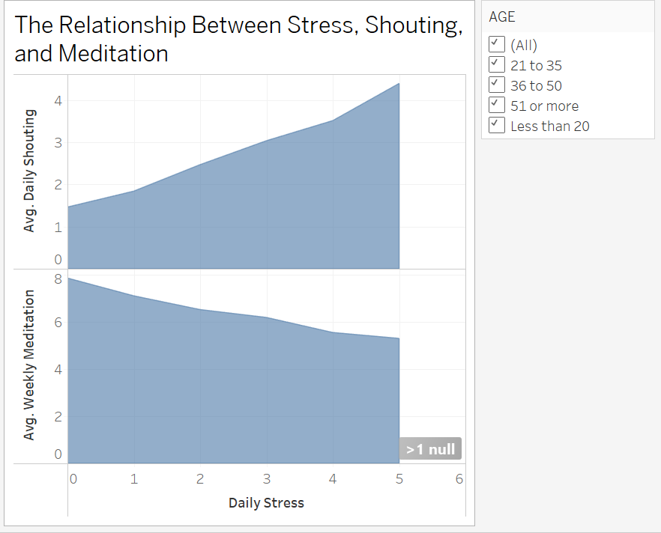
Common Sources of Stress
Low to moderate stress levels may lead to frustration and emotional outbursts.
As stress increases, people shift towards mindfulness techniques like meditation to cope.
Encouraging meditation earlier (at lower stress levels) may prevent unhealthy emotional responses like shouting.

Slide 5
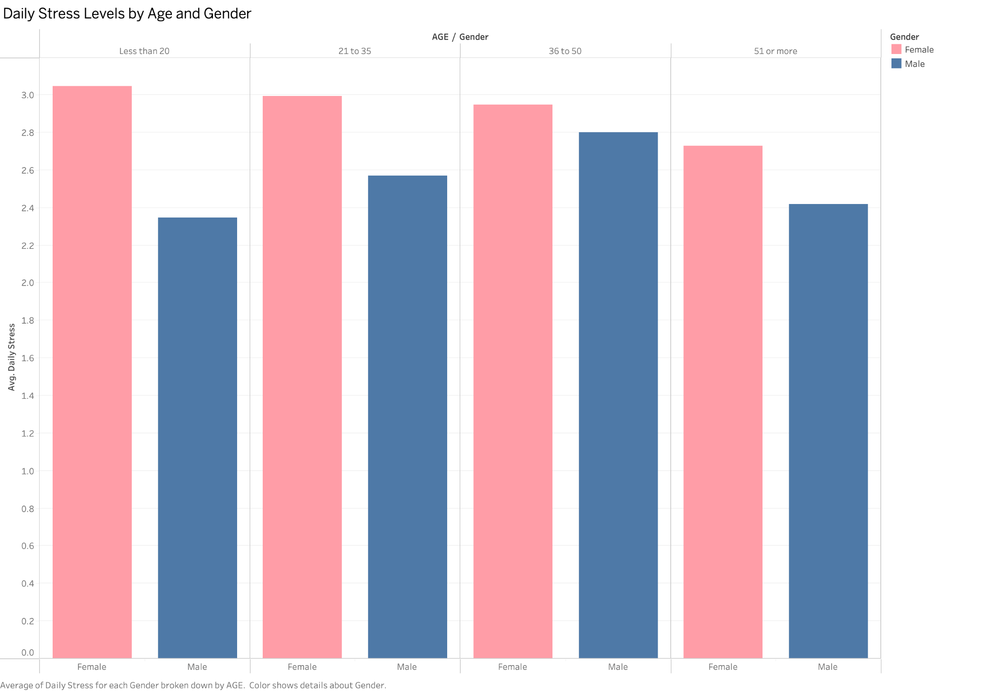
Daily Stress Levels by Age and Gender
Younger females experience the highest stress, while older males have the lowest.
The gender stress gap narrows with age, suggesting life stabilization over time.
Further analysis could explore how factors like work-life balance, income, or social support contribute to these trends.

Slide 6
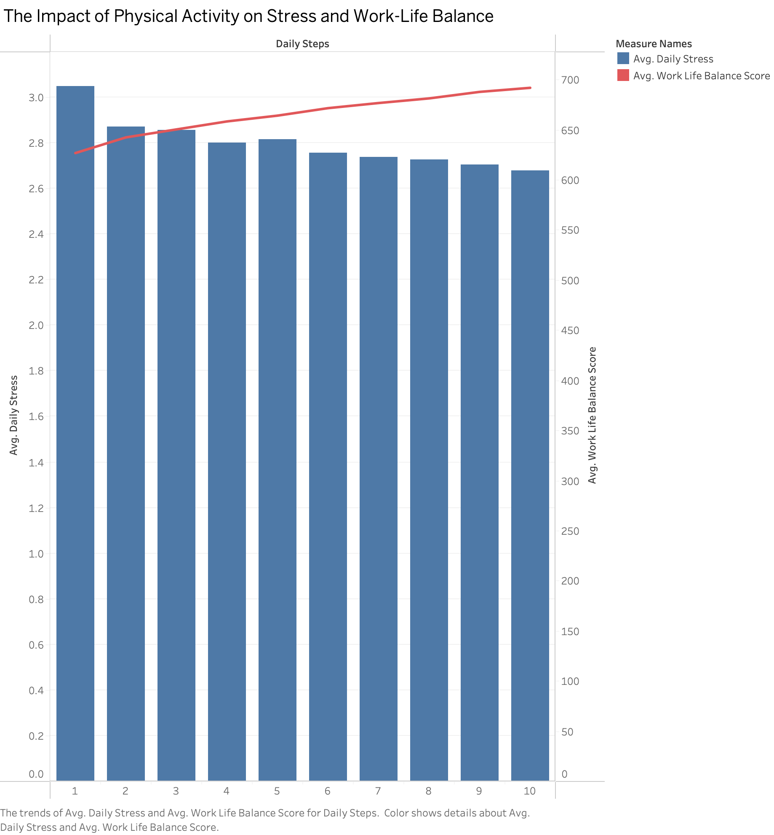
The Impact of Physical Activity on Stress and Work-Life Balance
Physical activity is linked to lower stress and better work-life balance.
Encouraging daily movement (e.g., walking, exercise) could help manage stress levels effectively.
Even small lifestyle changes, such as walking more each day, can lead to improved work-life satisfaction.

Slide 7
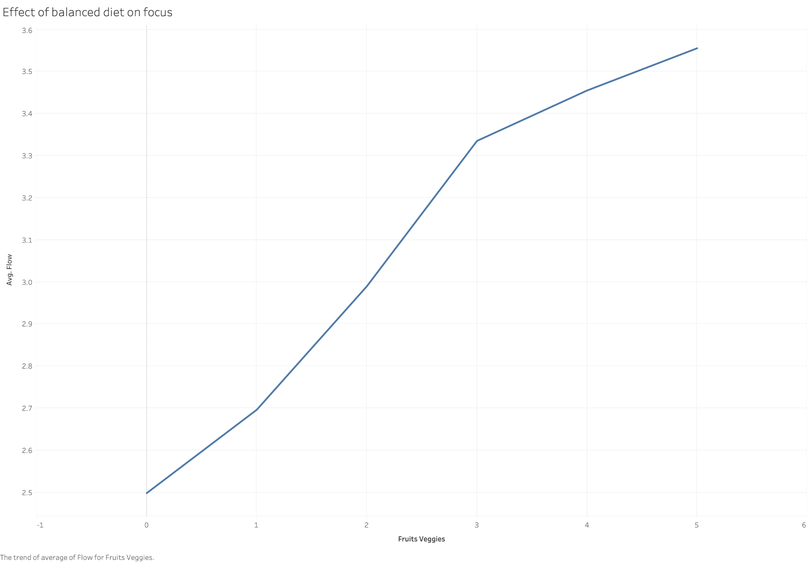
The Effect of a Balanced Diet on Focus and Productivity
A balanced diet with sufficient fruits and vegetables enhances focus and productivity.
Even small improvements in dietary habits (moving from 1 to 3 servings) can yield significant benefits.
Future analysis could explore how diet interacts with sleep, stress, and exercise for cognitive performance.

Slide 8
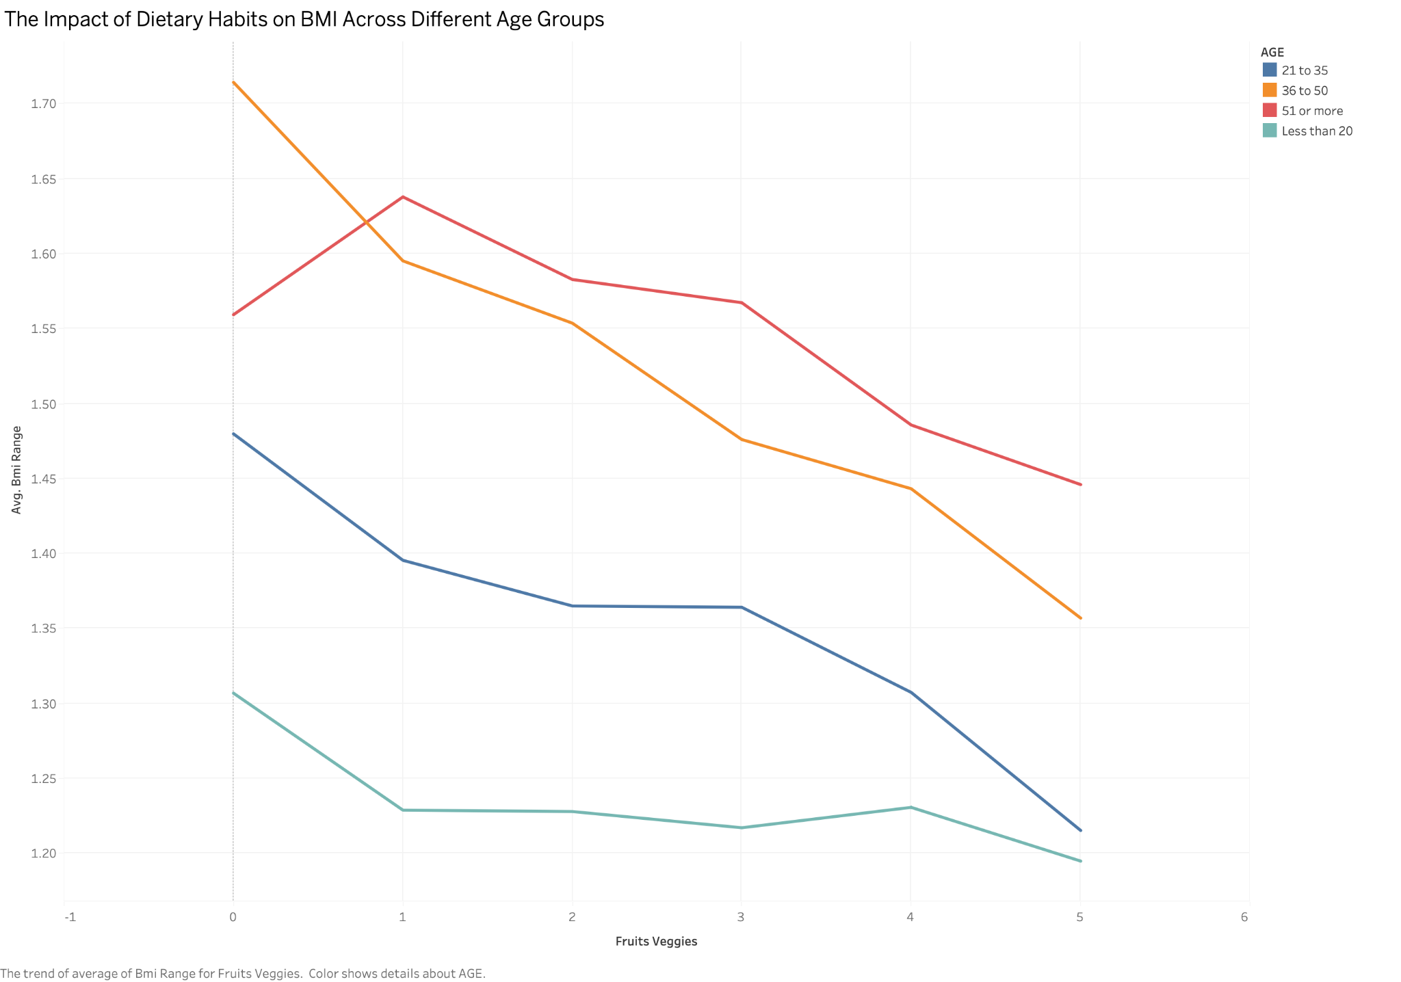
The Impact of Dietary Habits on BMI Across Different Age Groups
A diet rich in fruits and vegetables consistently leads to a lower BMI across all age groups.
Younger individuals may not see an immediate impact, but for older adults, the effect is more pronounced.
Encouraging higher fruit & veggie intake can be a crucial strategy for maintaining a healthy weight, especially as metabolism slows with age.

Slide 9
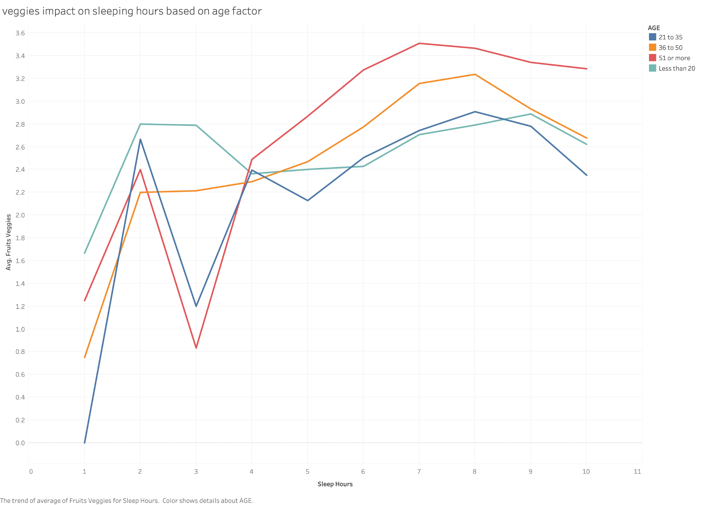
Impact of Sleep Duration on Fruit & Vegetable Consumption Across Age Groups
Healthier sleep habits are associated with higher fruit & vegetable consumption.
Younger individuals have more erratic dietary patterns, possibly influenced by inconsistent sleep schedules.
Encouraging stable sleep patterns (6-8 hours) may lead to better eating habits across all age groups.

Slide 10
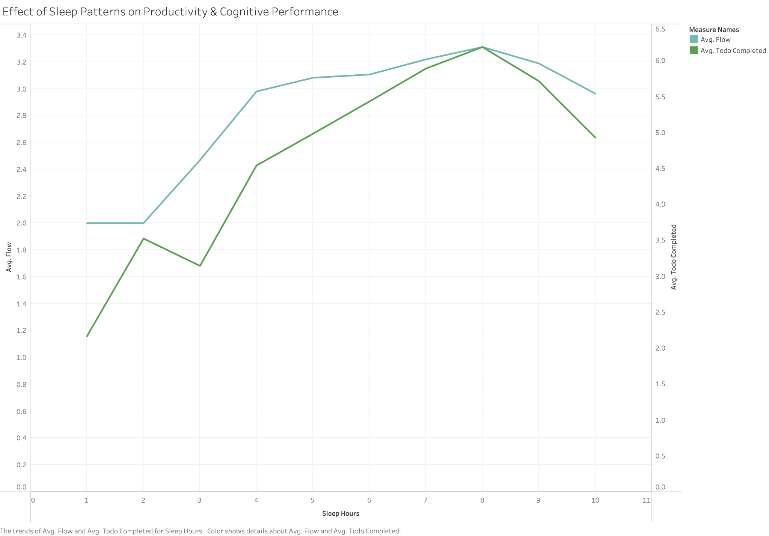
Effect of Sleep Patterns on Productivity & Cognitive Performance
The ideal sleep range for productivity and focus is 6-7 hours per night.
Too little sleep (<4 hours) drastically reduces both cognitive ability and task completion.
Excessive sleep (>8 hours) also slightly lowers productivity, suggesting a balance is key.

Slide 11
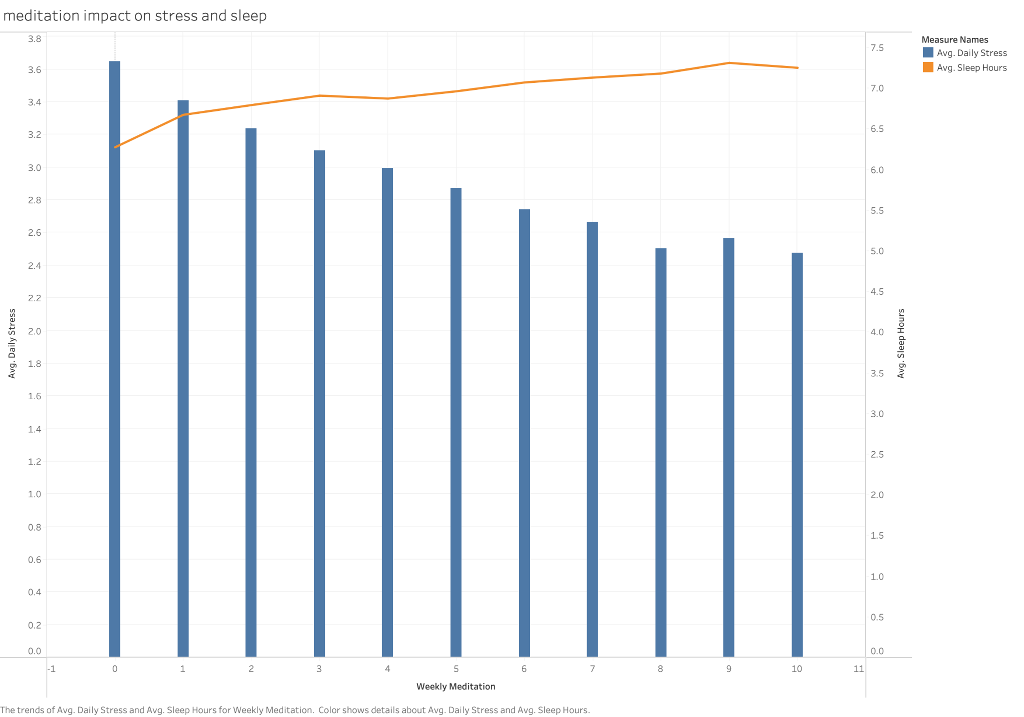
The Impact of Meditation on Stress and Sleep Patterns
Meditation is an effective strategy for reducing daily stress.
It also contributes to improved sleep patterns, though the effect is more gradual.
Regular meditation (at least 3-5 times per week) provides noticeable benefits.

Slide 12
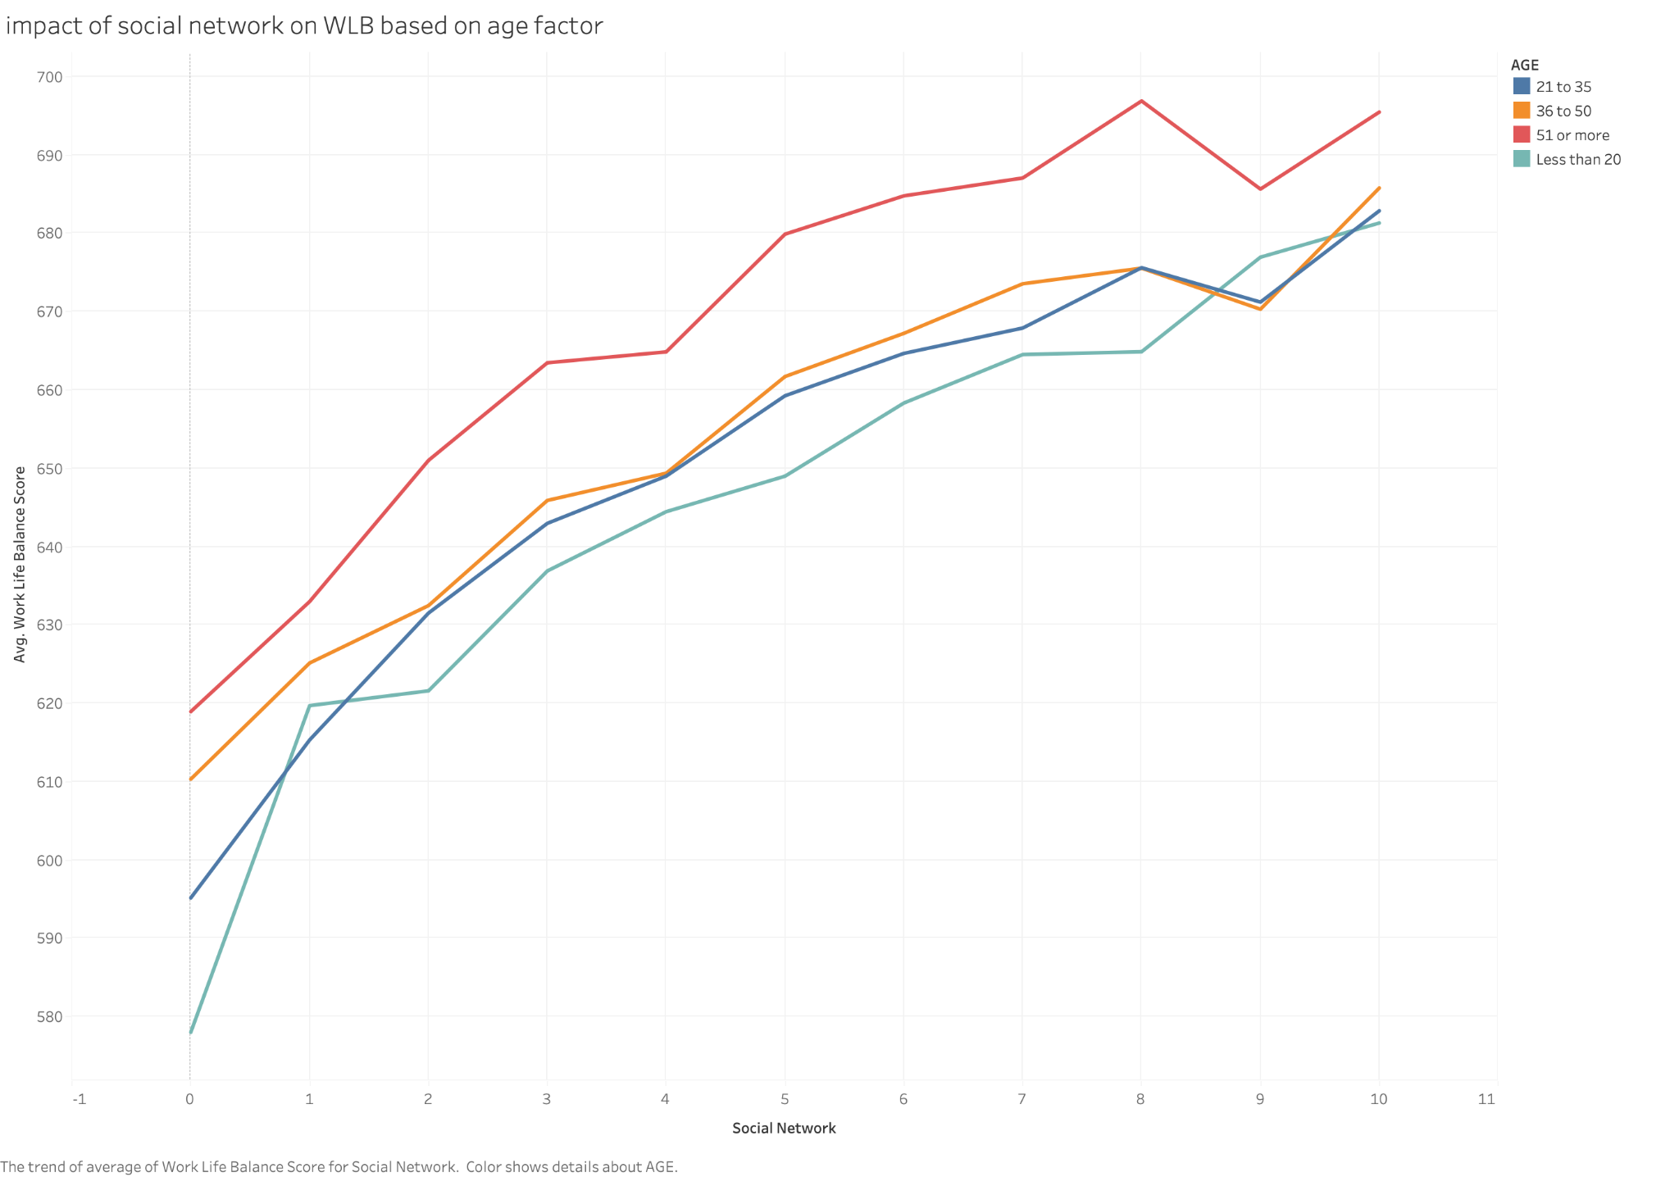
Impact of Social Networks on Work-Life Balance Across Age Groups
A strong social network positively impacts work-life balance, especially in older age groups.
Younger individuals may need to focus on building social connections for greater balance.
The benefit of social interactions plateaus after a certain point, suggesting quality matters more than quantity.

Slide 13
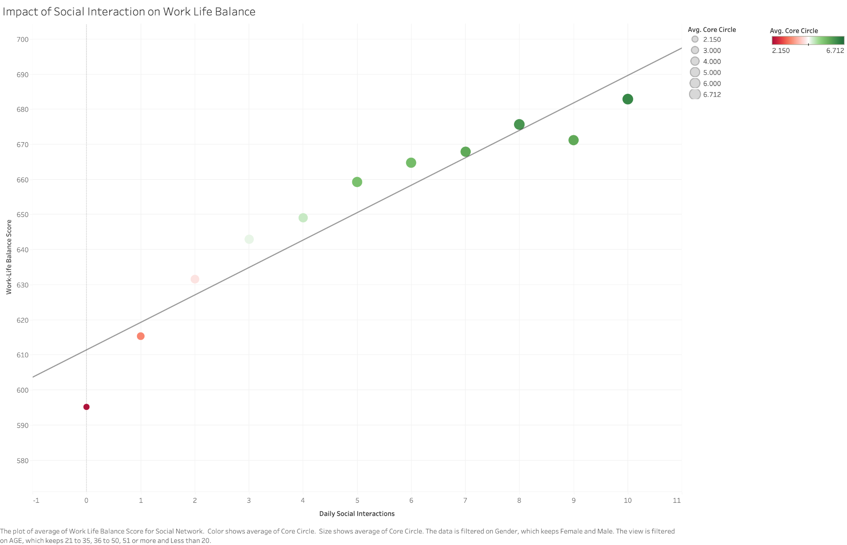
The Impact of Social Interaction on Work-Life Balance
Frequent social interactions contribute positively to work-life balance.
A strong core circle (close friends) enhances this effect.
Encouraging social engagement can improve overall life satisfaction across genders.

Slide 14
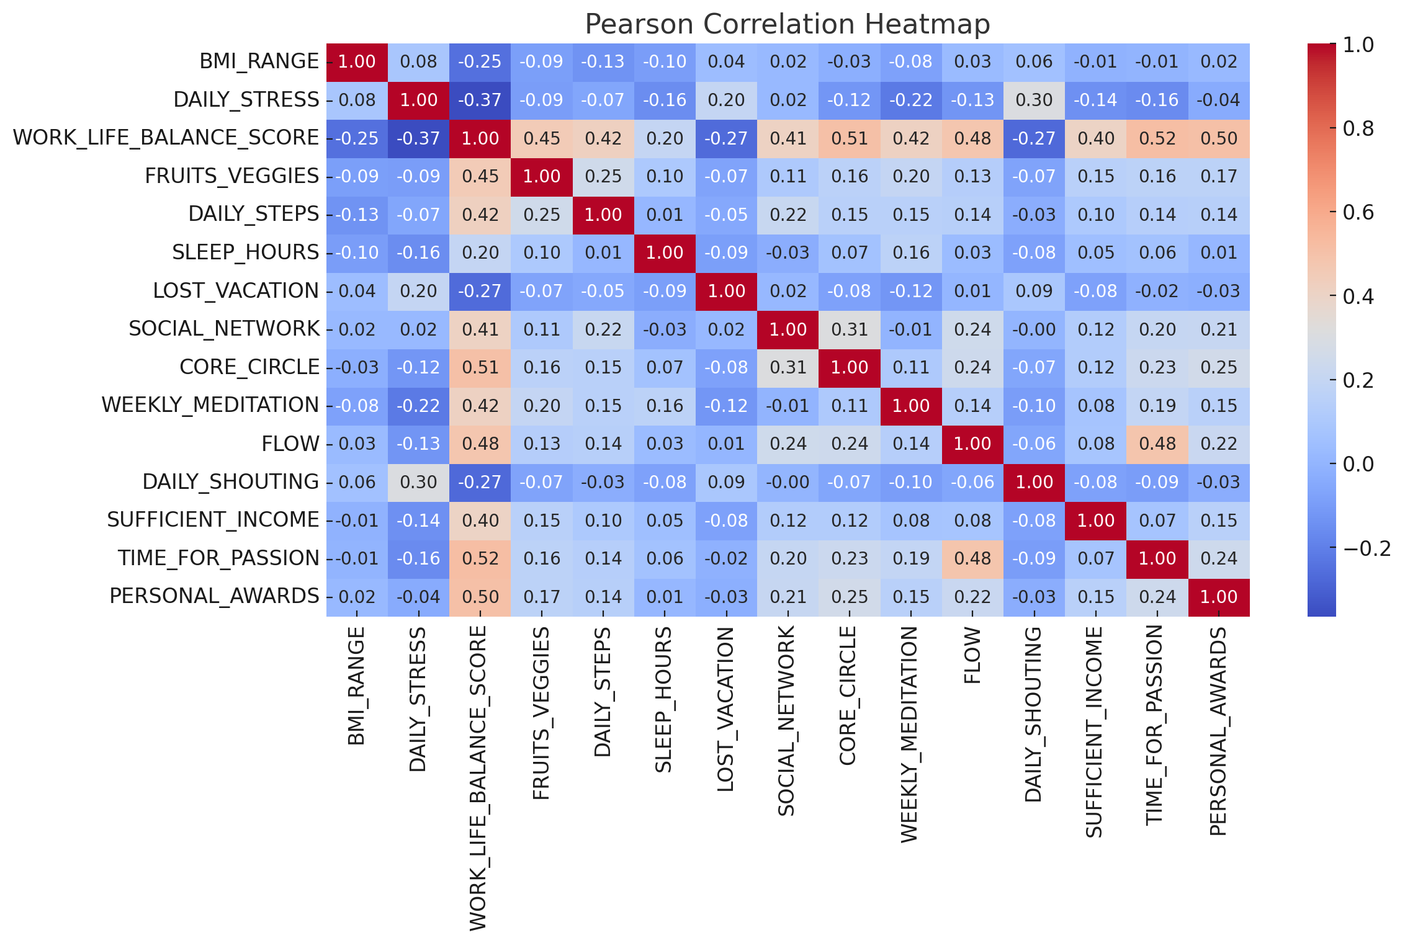

Correlation Heatmap
Physical Health (BMI_Range)
Positively correlated with Daily_Stress (0.083)
Positively correlated with Daily_Shouting (0.060)
Negatively correlated with Work_Life_Balance (-0.252)
Mental Health (Daily_Stress)
Positively correlated with Daily_Shouting (0.302)
Positively correlated with Lost_Vacation (0.196)
Negatively correlated with Flow (-0.129)
Overall Satisfaction (Work_Life_Balance_Score)
Negatively correlated with Daily_Stress (-0.365)
Negatively correlated with Daily_Shouting (-0.273)
Positively correlated with Flow (0.478)

Slide 15
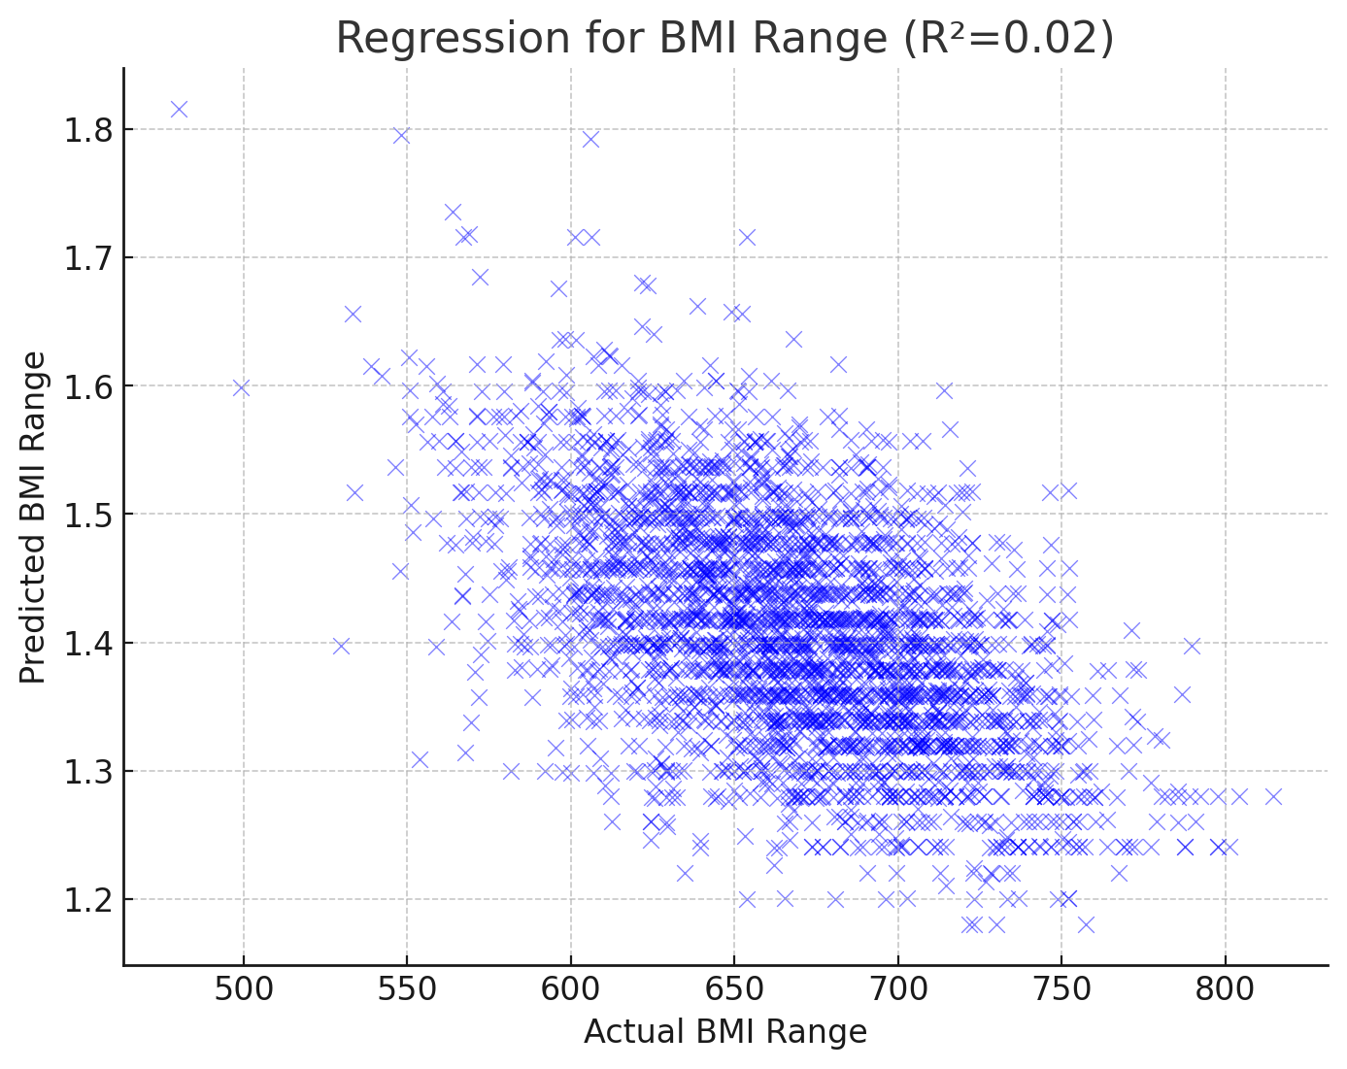
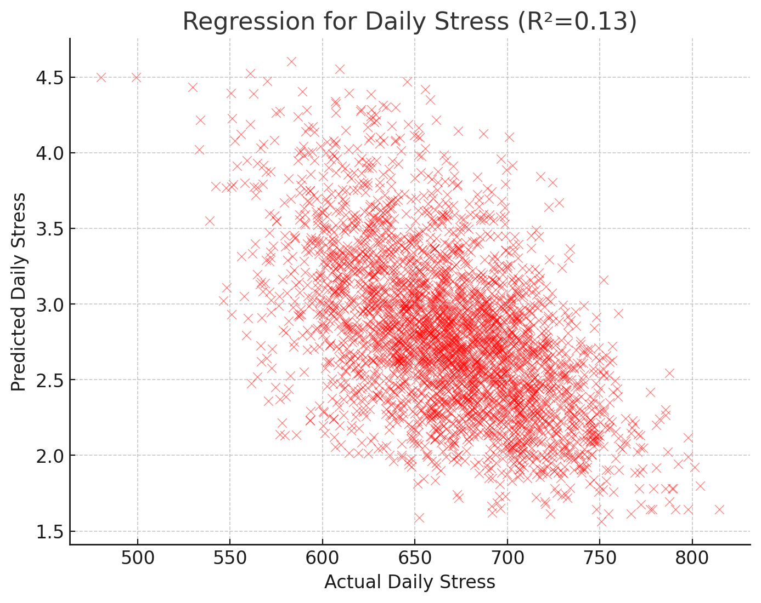
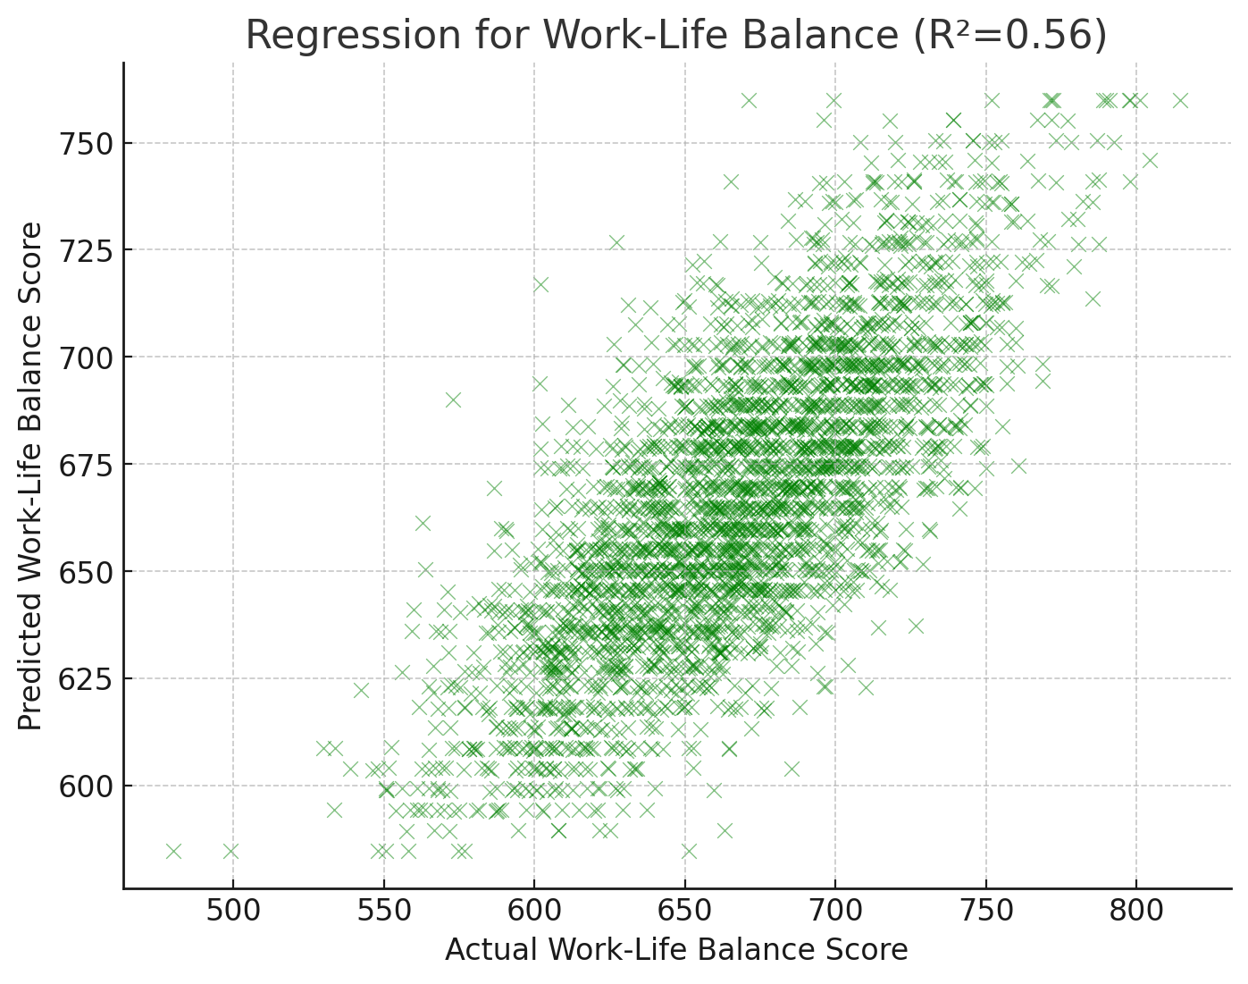
Regression Analysis
Physical Health
Mental Health
Work-life Balance
Daily_Shouting, Social_Network, and Weekly_Meditation impact stress levels, but stress is influenced by other psychological and environmental factors not captured here.
Higher social engagement and meditation reduce stress.
Sufficient_Income, TimeForPassion, Personal_Awards, and Flow are significant drivers of work-life balance.
Having time for personal interests and financial stability are key for overall satisfaction.
Factors such as Fruits_Veggies, Daily_Steps, Sleep_Hours, and Lost_Vacation have minimal predictive impact on BMI.
This suggests that BMI is influenced by additional unmeasured factors like genetics, medical history, and long-term dietary habits.

Slide 16
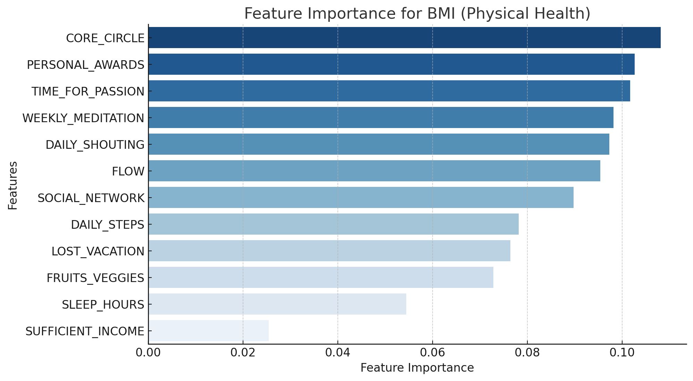
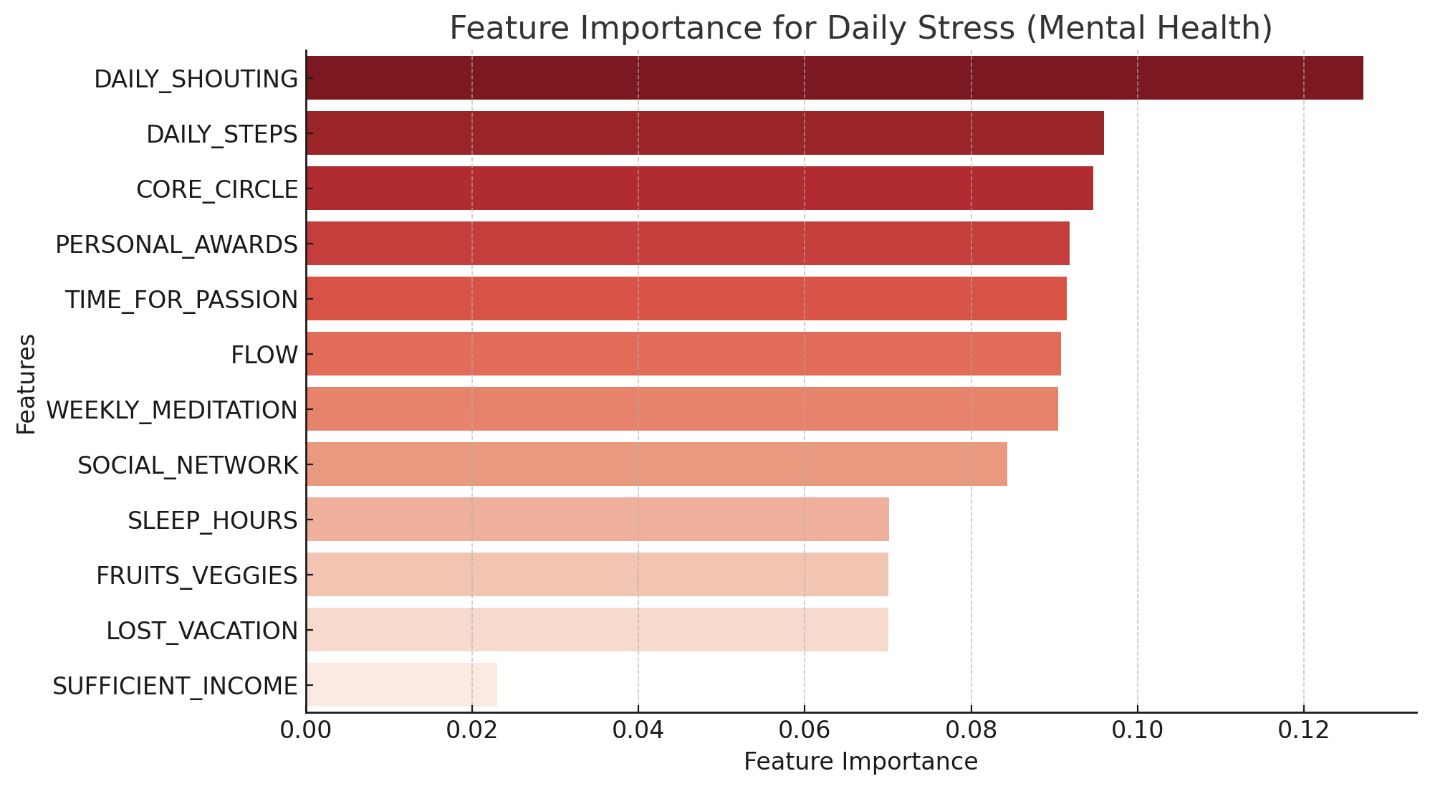
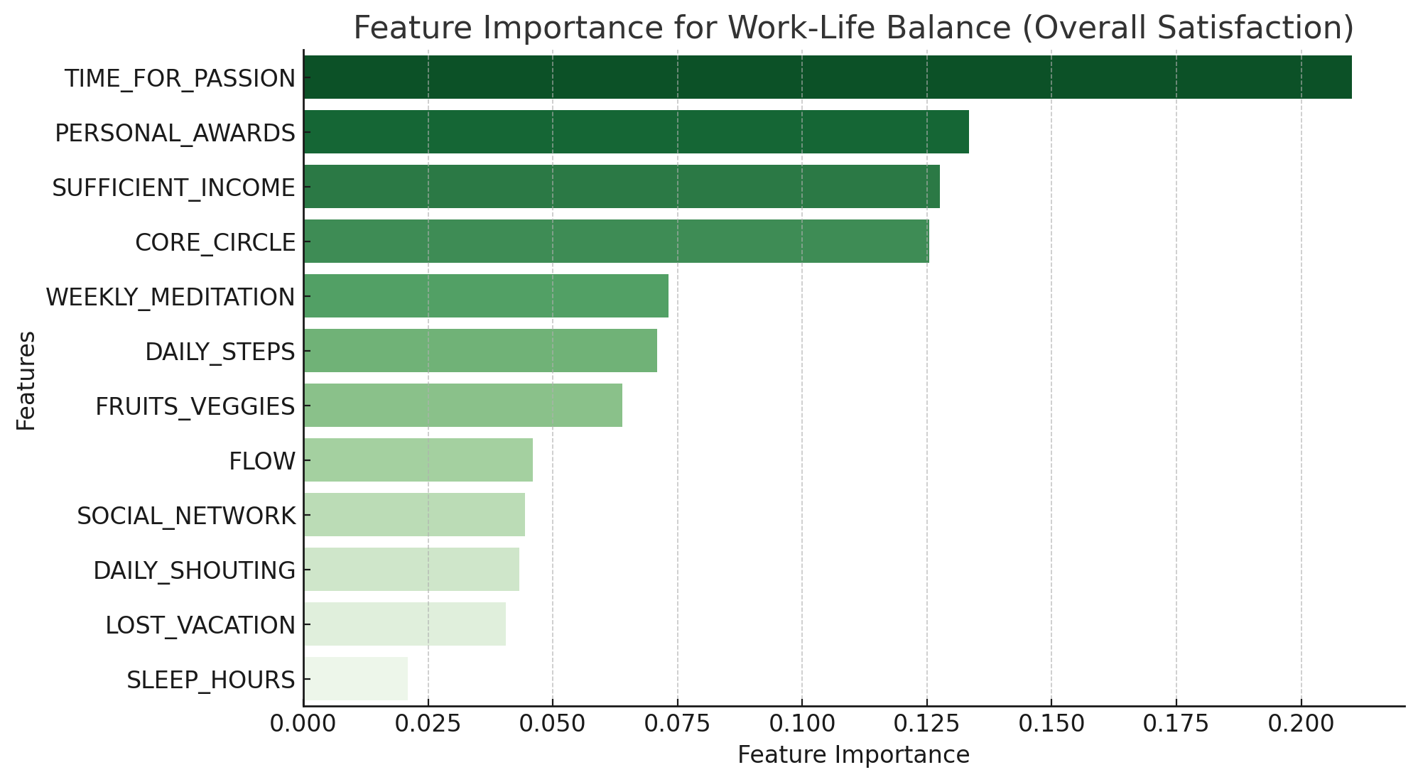
Feature Importance
Physical Health
Mental Health
Work-life Balance
Stress is most impacted by emotional expression (shouting), social connections, and fulfilling activities.
Income matters, but personal passions and social networks are even more crucial for well-being.
Traditional factors like Fruits_Veggies and Daily_Steps were not top contributors, suggesting that psychosocial factors (support, passion, recognition) influence BMI more.

Slide 17
Cluster Analysis
Attributes | Cluster 0 (Burnout) | Cluster 1 (Balanced) | Cluster 2 (High Achiever)
Daily Stress | High | Moderate | High
BMI Range | Unstable, High | Stable, Moderate | Stable, High
Work-life Balance Score | < 500 | >700 | 500 - 700
To-Do Completed | < 3 | 3 – 5 | > 5
Age | 18 - 28 | 35 – 50 | 28 - 40
Gender | Mostly Female | Mostly Male | Evenly Distributed
Sleep Hour | < 3 hours | 6 -8 hours | 5 – 7 hours
Daily Shouting | High | Low | Moderate
Lost Vacation | > 7 | 3 -5 | > 5
Time for Passion | < 5 | 2 - 5 | < 2

Slide 18
Recommendations
Mental Health
Physical Health
Work-life Balance
Promote Vacation Usage
Healthy Meal Option
Shorten the Office Hours
Weekly Meditation
Gym Facility At Workplace
Personal Development Programs
Counseling Service
No fixed desk
Team Building Activities
Provide Recognition
Recreational Activity area
Incentives and Bonus for Achievements

Slide 19
Thank You

